Slide 1

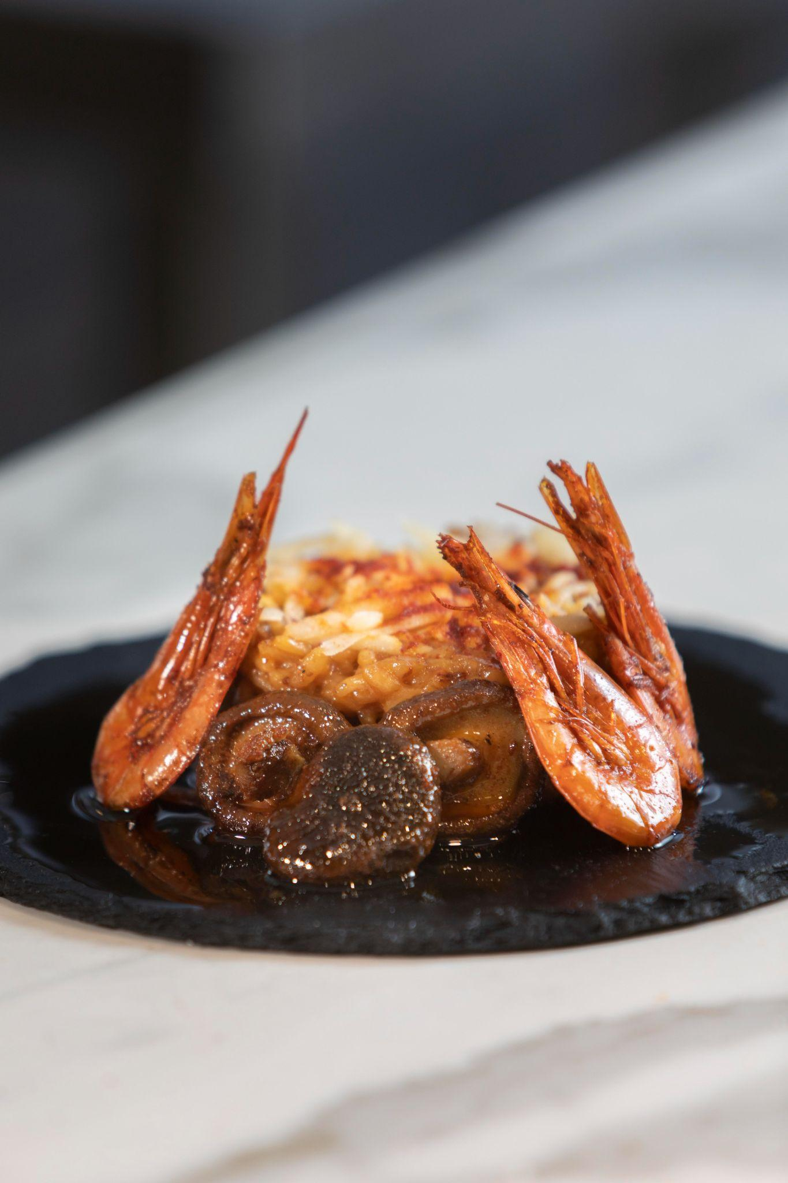

Mini Project 1
- PROPOSAL -
Mark Howell Espinol
August 18, 2023

Slide 2
Summary
Topic: Recipe Blog
Title & Project Logo
Color Palettes
Purpose
Target Users
Site Map
Wireframe Templates

Slide 3

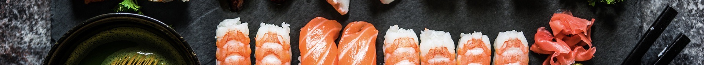
2.0 Title & Project Logo

Slide 4
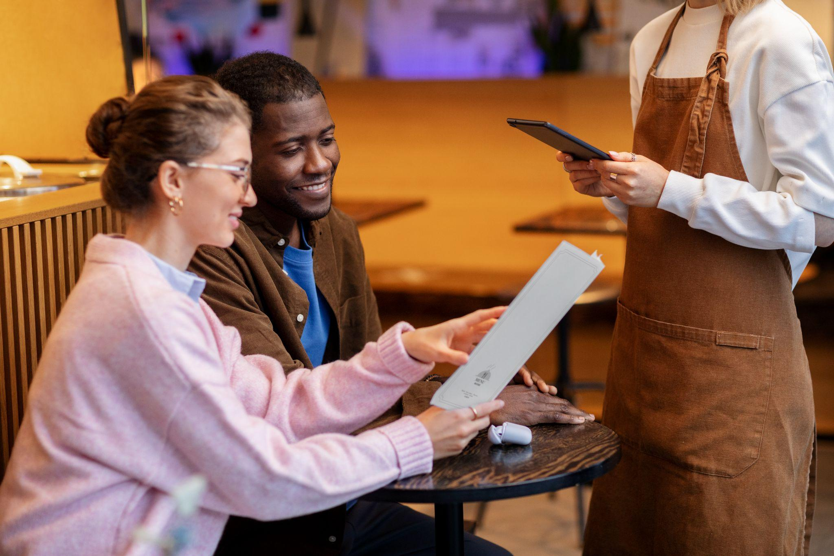



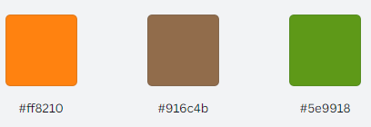
3.0 COLOR PALETTES

Slide 5
4.0 Purpose
01.
02.
03.
Inspiration and Ideas
Guidance and Instruction
Community and Sharing
05.
06.
Meal Planning
Creative Outlet
04.
Preservation and Record

Slide 6
05
Target Users

Slide 7
5.0 Target Users
Home Cooks and Food Enthusiasts
Beginner Cooks
Health-Conscious Individuals

Slide 8
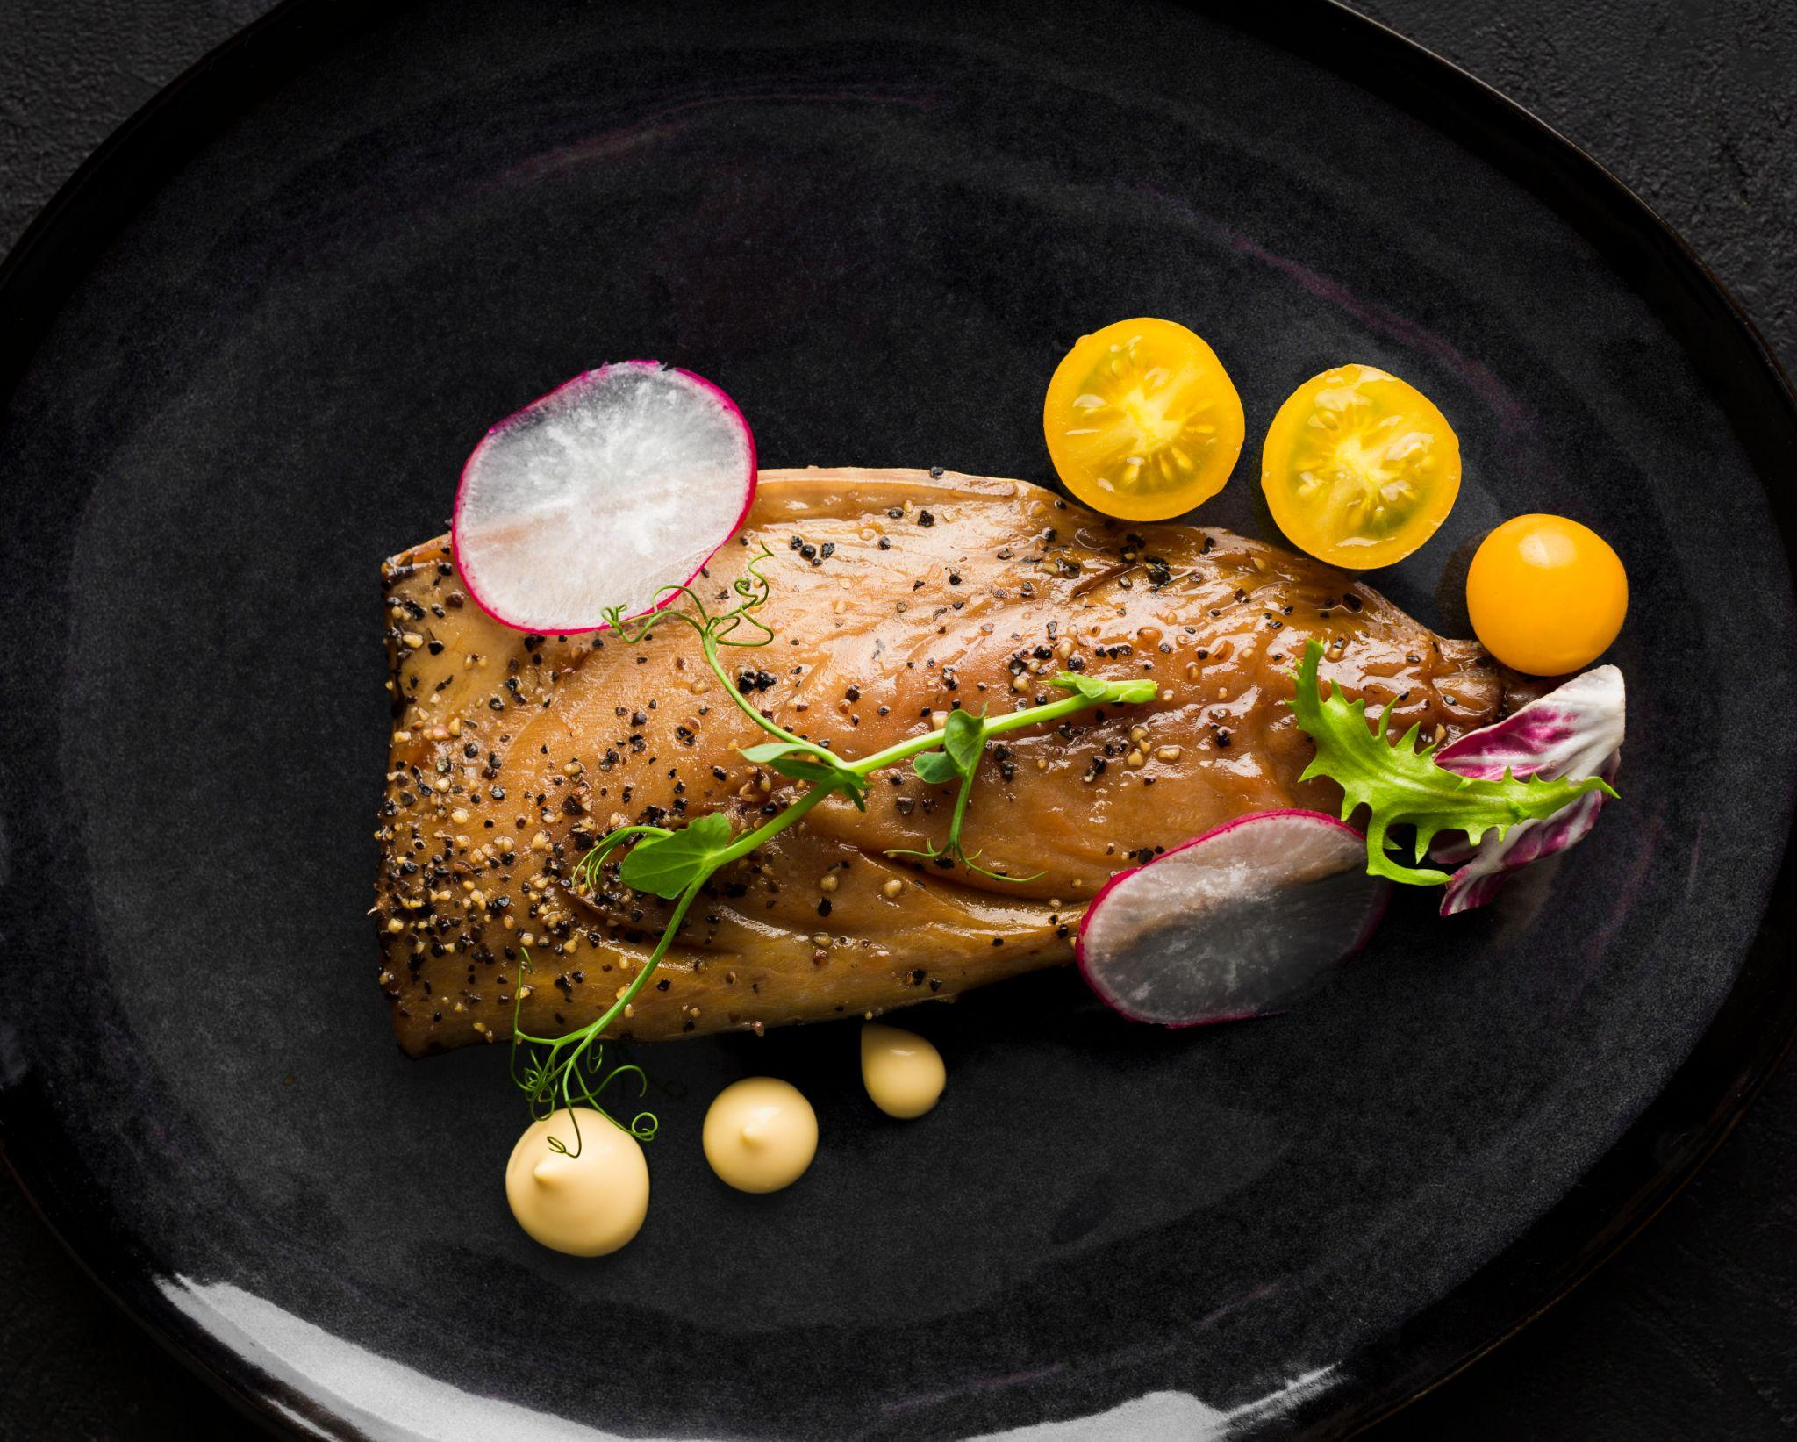
6.0 THE
SITE MAP
Home
About
Recipe
Sign up
Login
Search bar
Contact Us
Purpose
&
Target Users
Brand
Message / Tagline
Forms
Browse
Recipes
List of Dishes
List of Dishes
Upload
Recipe

Slide 9
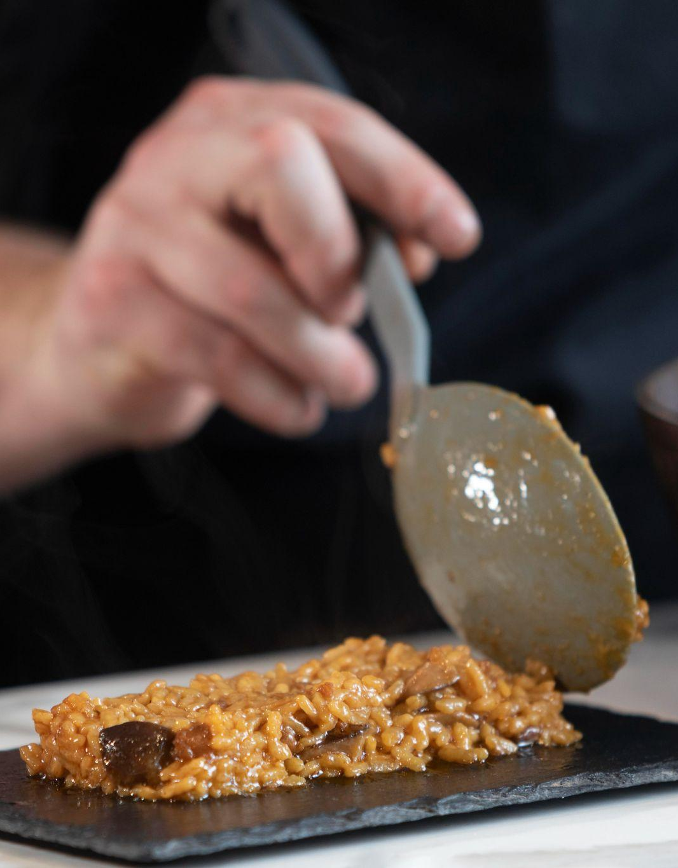
7.0 WIRE FRAME / MOCKUP

Slide 10
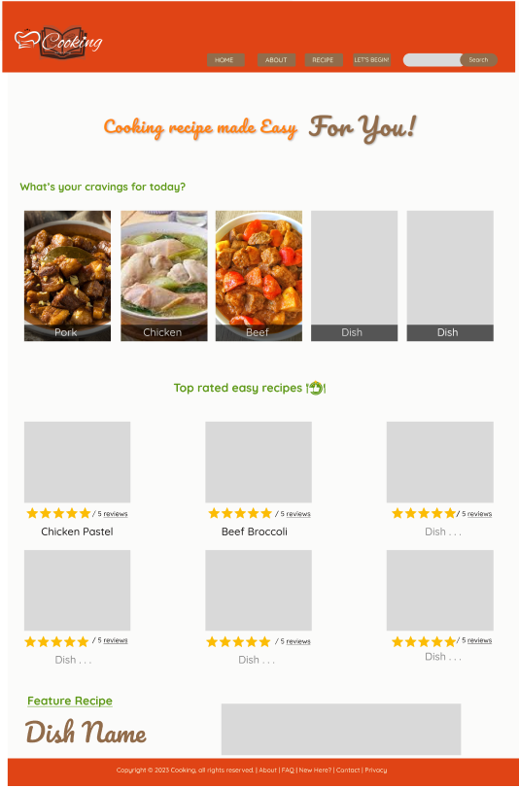
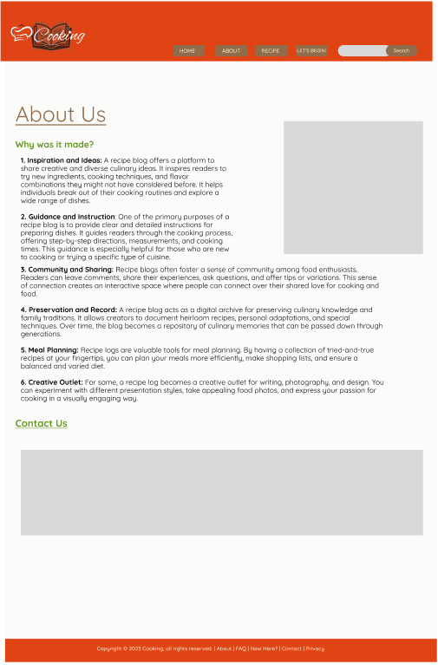
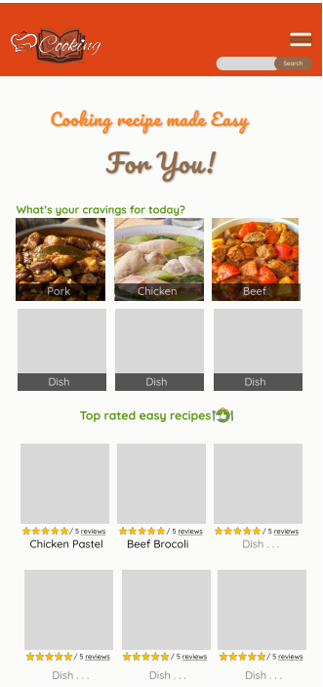
Sample Mobile
Sample Webpage

Slide 11
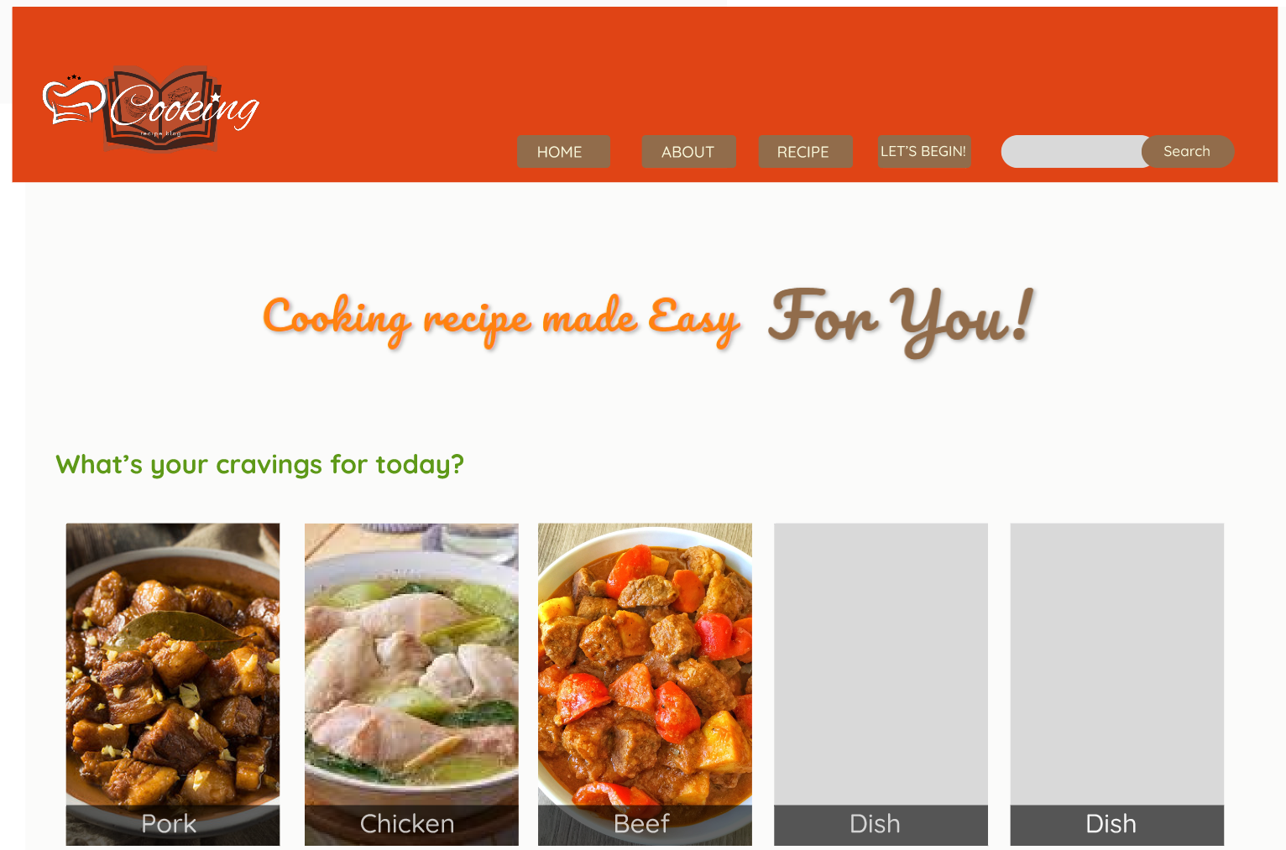
SNEAK PEEK
Personal Computer
Tablet
Mobile Phone

Slide 12
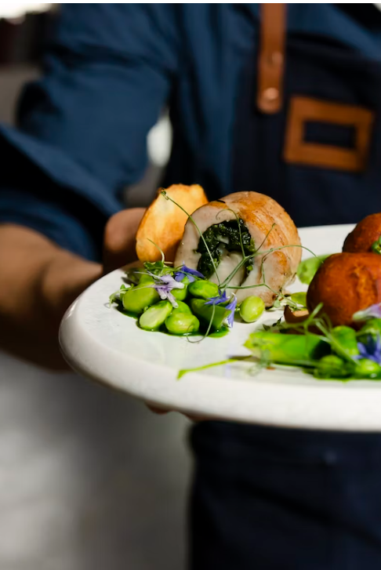
THANK YOU!

